Slide 1
Good morning!
Everybody

Slide 2
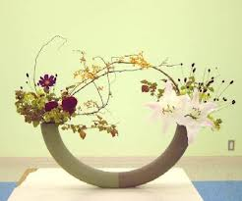
Unit 1- LEISURE ACTIVITIES
Lesson 3- A CLOSER LOOK 2

Slide 3
Look at the sentences:
I like eating oranges.
My sister enjoys cooking meals.
They prefer learning English.
Hoa dislikes reading books.
We hate to get up early.

Slide 4
I. GRAMMAR.
1. Read the conversation and underline verbs that are followed by a gerund.
Verbs
Love
Like
Hate
Prefer
Gerund (V_ing)
To infinitive (To V_inf)
+
Ex: She loves going out with her friends.
= She loves to go out with her friends.

Slide 5
Learning tip
Verbs of liking
Adore
Love
Like, enjoy, fancy
Don’t mind
Hate
Detest
+ Gerund (V_ing)

Slide 6

2. Tick the box. Then listen to check.
 | Gerund | Gerund and to-infinitive
1. love
2. enjoy
3. detest
4. prefer
5. fancy
√
√
√
√
√

Slide 7
3. Write the correct form of the verbs.
Mai enjoys …………(make) crafts, especially bracelets.
People in Britain love ………….………...(watch) TV in their free time.
Do you fancy …....................(skateboard) in the park this Sunday?
Nick likes …………….....…(learn) Vietnamese.
Ngoc hates ……………..(sit) at the computer for too long.
making
watching/ to watch
skateboarding
learning/ to learn
sitting/ to sit

Slide 8
4. Write the sentences.
Verb | You | Your friend
adore
love
fancy
don’t mind
don’t like
detest
I adore collecting dolls.
Lan adores gardening.

Slide 9
5. Look at the following email.
Hi, my name’s Duc.
How are you? This is what I like do in my free time. I
often play video games or watch TV. Or I go to the park
and play football with my friends. I enjoy do this very
much! I sometimes help my parents too. If I have
homework, I’ll try to finish it first before I do anything
else. But I don’t like have lots of homework! I don’t mind
to do homework. But I hate spend all evening on it! On
Saturday or Sunday, I love eat out with my family. The
food is delicious!
What about you?
Best,
Duc

Slide 10
a. Find out six grammar mistakes and correct them.
like do –
enjoy do –
don’t like have –
don’t mind to do –
hate spend –
love eat -
like doing/ to do
enjoy doing
don’t like having
don’t mind doing
hate spending/ to spend
love eating/ to eat

Slide 11
b. Answer the questions.
1. How many activities does Duc mention in his email?
2. Which two activities do you think he enjoys the most?
The activities Duc mentions in his e-mail are: playing video games, watching TV, going to the park, playing football, helping his parents, doing homework, and eating out with his family.
The two activities he enjoys the most are playing football with his friends, and eating out with his family.

Slide 12
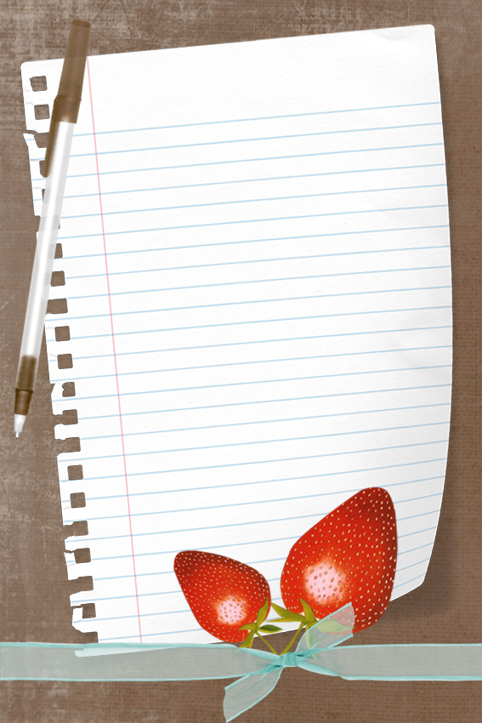
HOMEWORK
+ Learn the structures by heart.
+ Do exercise 6 on page 10/textbook.
+ Prepare for:
Unit 1 - Communication.

Slide 13


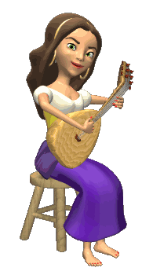

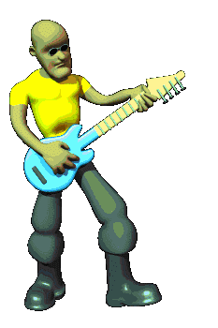
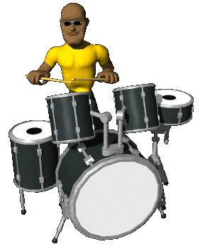






THANK YOU FOR ATTENTION!
GOOD BYE!
the end

